Slide 1
Project CANDL
Final Presentation
November 23, 2020

Slide 2
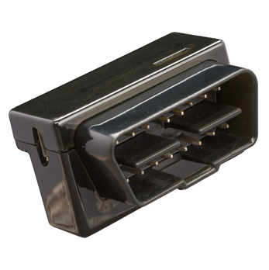
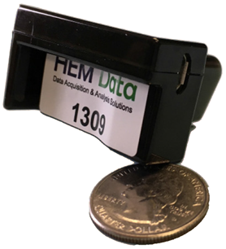
Problem Statement
Current product: HEM Data OBD Logger
Reads CAN bus
Logs GPS data
Stores info
Uploads over 3G to remote server
Cost of current solution: over $800 per logger
Need a more cost-effective solution
New device should have upgrades over the current product

Slide 3
Objectives
Accurately read and record CAN messages and sensor data from golf, utility, and consumer vehicles
Log location information via GPS
Upload captured data to a remote server via LTE or Wi-Fi
Process uploaded data and generate reports

Slide 4
Deliverables
Printed Circuit Board (PCB) Files
Development Boards with Working Code Loaded
Schematics
Design Notes, Files
Testing Data
Code and Documentation
Notes:
Ethan

Slide 5
Design Sections
Hardware
Power Supplies
Microcontroller & CAN
Wireless Communication Modules
Software
Embedded
RTOS & MQTT
Wireless Configuration
Data Collection
Back-End
Notes:
Ethan

Slide 6
Hardware
Schematic and PCB Design

Slide 7
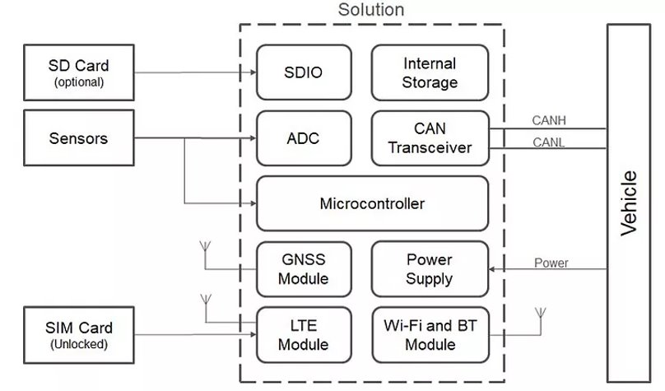
System Architecture

Slide 8
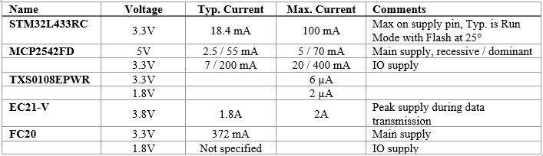
Power Supplies
Component supply requirements table
Four power domains: 3.3V, 3.8V, 1.8V, 5V
Three power supply ICs chosen

Slide 9
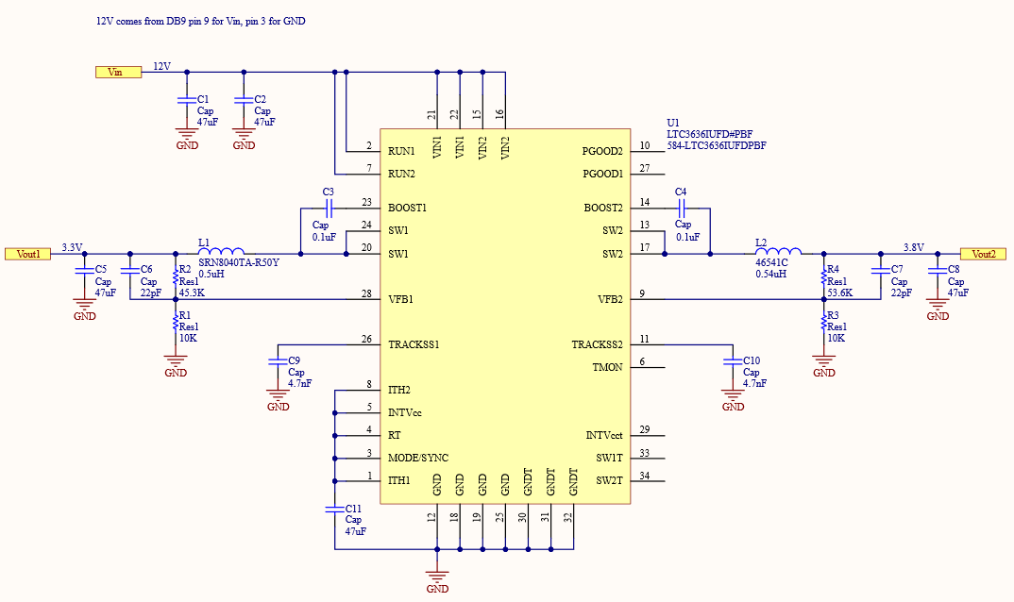
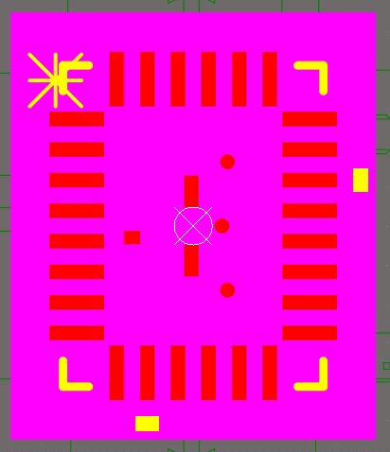
Power Supplies
LTC3636​
Dual-Channel SMPS​
3.3V (Microcontroller, Wi-Fi Module, CAN Transceiver, Level Shifter)​
3.8V (Cellular Module)​
Up to 6A on each rail​
12V input​
$4.45 @ 1k units​

Slide 10
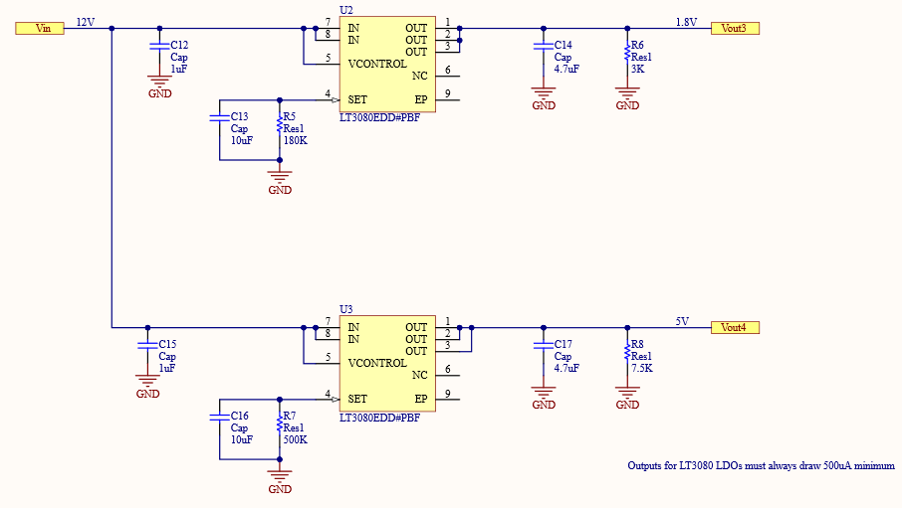
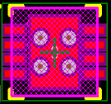
Power Supplies
LT3080 (x2)​
Single-Resistor LDO​
5V and 1.8V​
Up to 1.1A​
12V input​
$1.08 @ 1k units​
500µA on output required to operate correctly

Slide 11
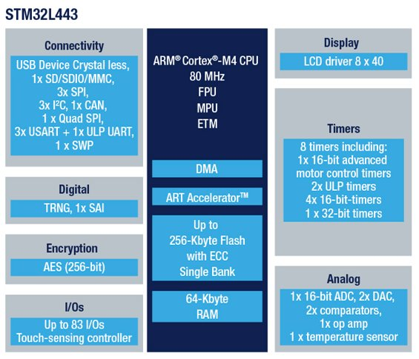
Microcontroller
STM32L443RC
32-bit, ARM Cortex-M4, 80 MHz
256KB Flash, 64KB SRAM
1.71V – 3.6 V
LQFP64 vs UFBGA64
QFPs are suspectable to bent pins, easier to spot, and rework much easier.
Interfaces
4 USART
CAN
USB 2.0
3 SPI
SDMMC
$2.85 @ 10k units

Slide 12
Microcontroller Peripherals
SDIO: is an interface designed as an extension for the existing SD card standard
CAN: CANRX_TX for the CAN_H and CAN_L
USART: Universal Synchronous Asynchronous Receiver Transmitter
UART: Universal Asynchronous Receiver Transmitter
is a microcontroller peripheral that converts incoming and outgoing bytes of data into a serial bit stream

Slide 13
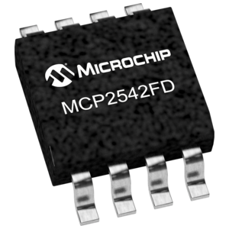
CAN & CAN Transceiver
CAN: Controller Area Network
allow microcontrollers and devices to communicate with each other's applications without a host computer
Electronic equipment for aviation and navigation
Car air-conditioning
CAN Transceiver: interface between a controller area network (CAN) protocol controller and the physical bus
Receive Data for CAN
$0.60 @ 1k units

Slide 14
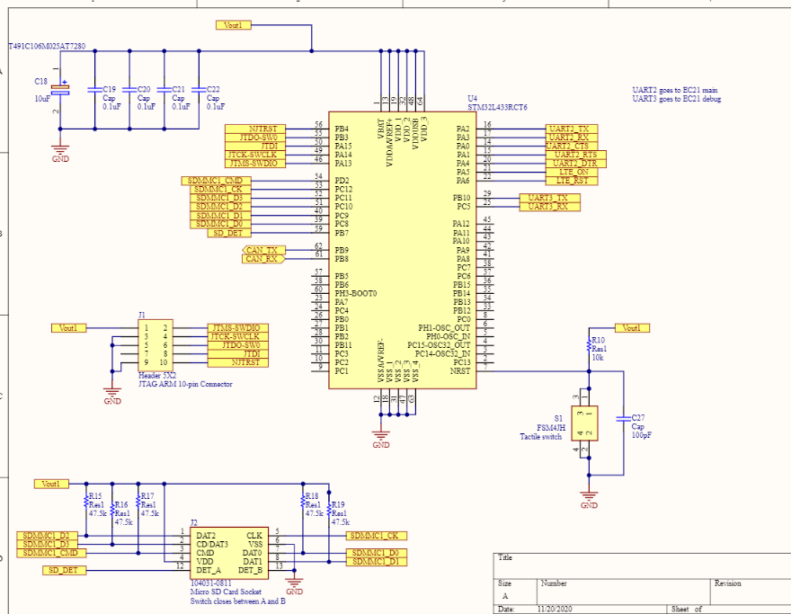
Microcontroller
Decoupling (4x 0.1uF , 1x10uF)
Reset Switch (Tactile Switch)

Slide 15
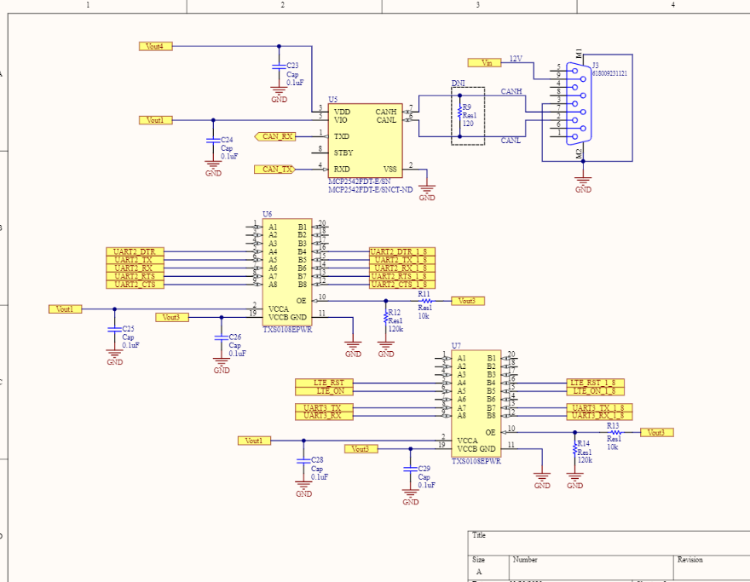
Microcontroller Peripherals
SDIO: SD-Card
USART: LTE
UART: EC21
CAN: CAN - TX_RX
Level Shifters: 3.3V to 1.8V

Slide 16

Wireless Modules
Cellular
Secondary means of communication
Wi-Fi
Primary means of communication

Slide 17
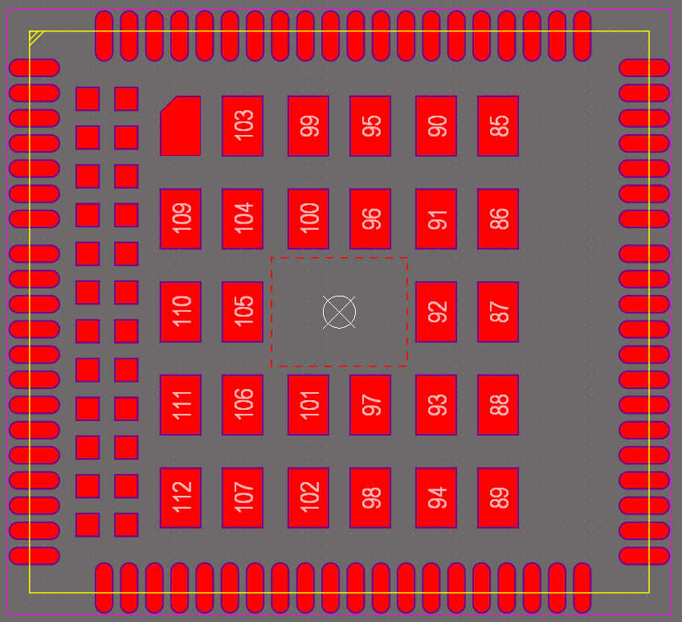
Wireless Modules - Cellular
Quectel EC21-V
LTE Cat 1(10Mbps down, 5 Mbps up)
GNSS included
UART or USB interface

Slide 18
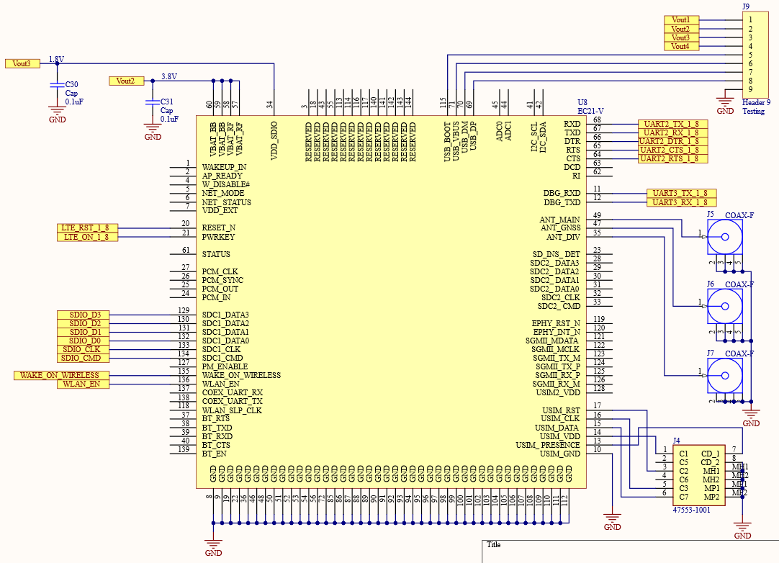
Wireless Modules – Cellular

Slide 19
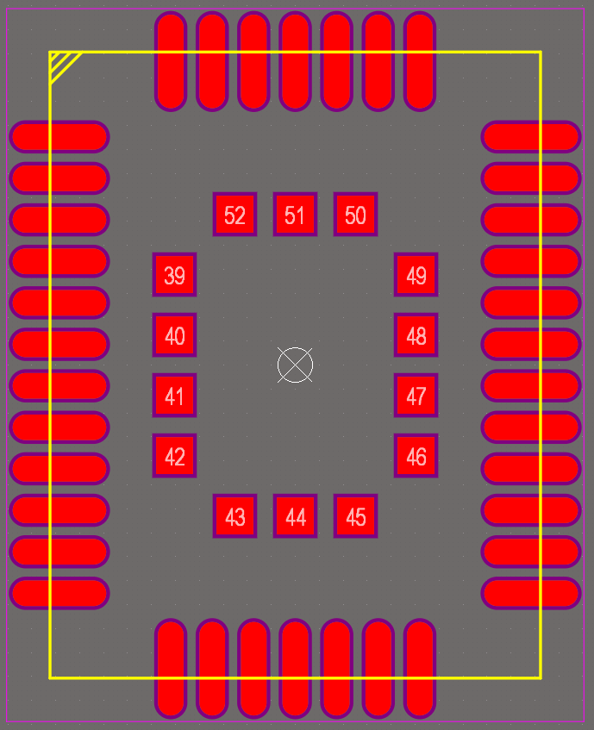
Wireless Modules – Wi-Fi
Quectel FC20
Compatible with EC21-V
Dual-band Wi-Fi
BT v4.2
Interfaces directly to EC21-V via SDIO
UART for BT functionality

Slide 20
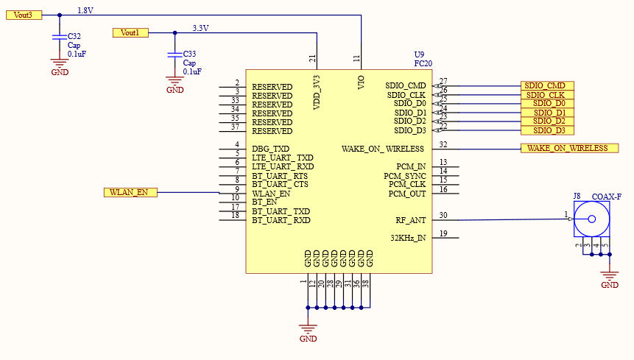
Wireless Modules – Wi-Fi

Slide 21
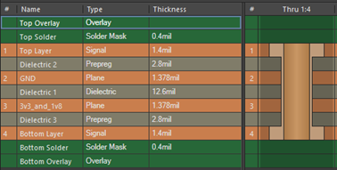
Printed Circuit Board
Four-layer design
Top Layer: Signal 1
Layer 2: Ground
Layer 3: Split power – 1.8V and 3.3V
Bottom Layer: Signal 2
Two boards created
Complete Board: includes all components
Test Board: excludes RF components (LTE, Wi-Fi) and adds headers for testing connections to cellular development kits
Future improvements: shields, more layers, ground pours and traces, RF noise reduction

Slide 22
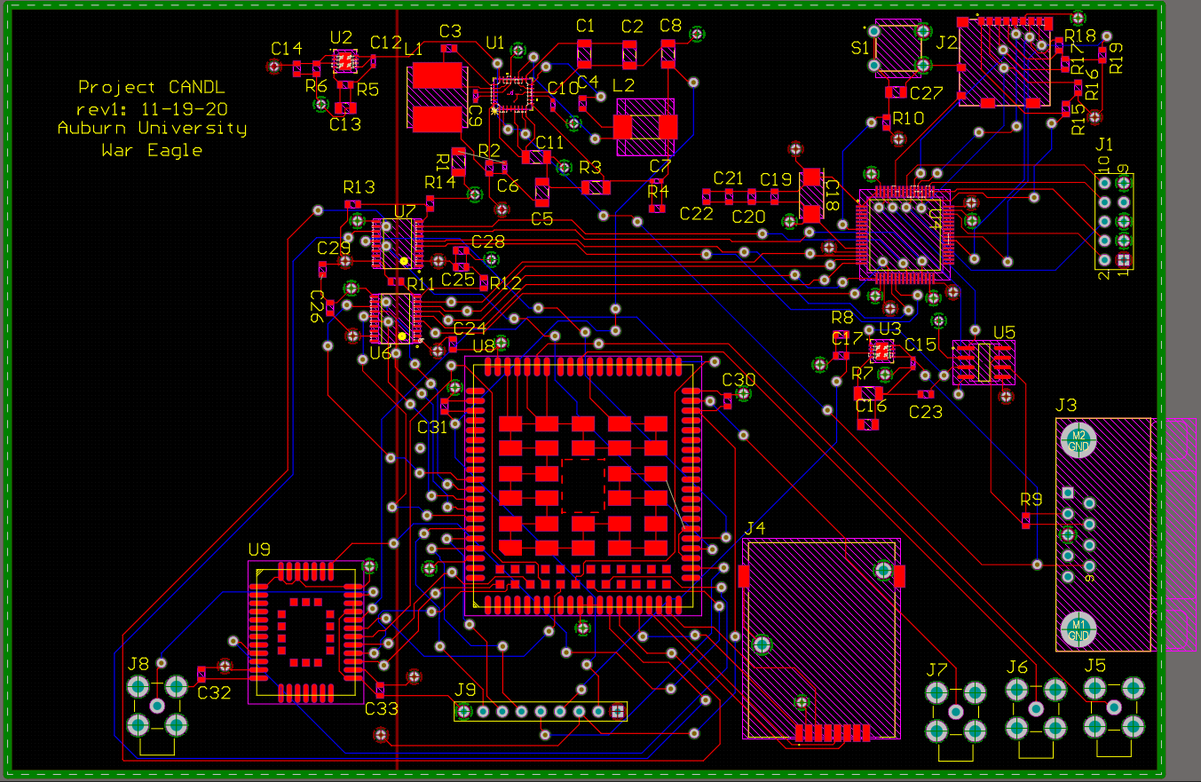

Slide 23
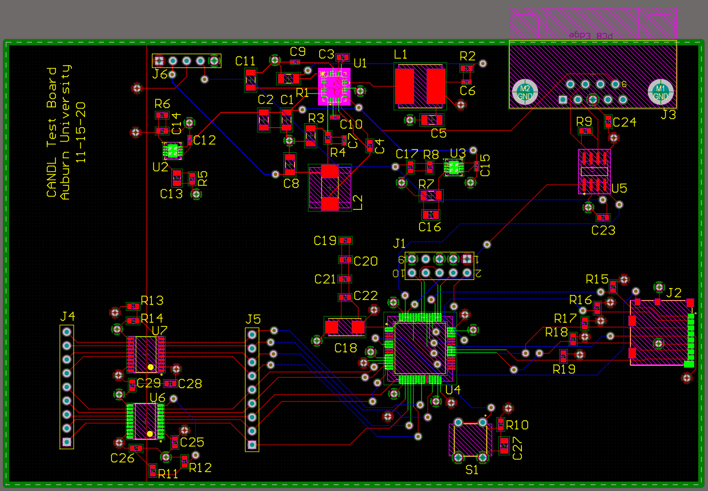

Slide 24
Embedded Software
RTOS, Wireless Communications, Data Collection

Slide 25

RTOS
RTOS – Real Time Operating System
Manages memory and threads
Used in embedded systems because it uses a small amount of resources
We are using Amazon’s FreeRTOS
Good documentation
Widely used and supported
Two threads
Store CAN data
Send data to the server

Slide 27
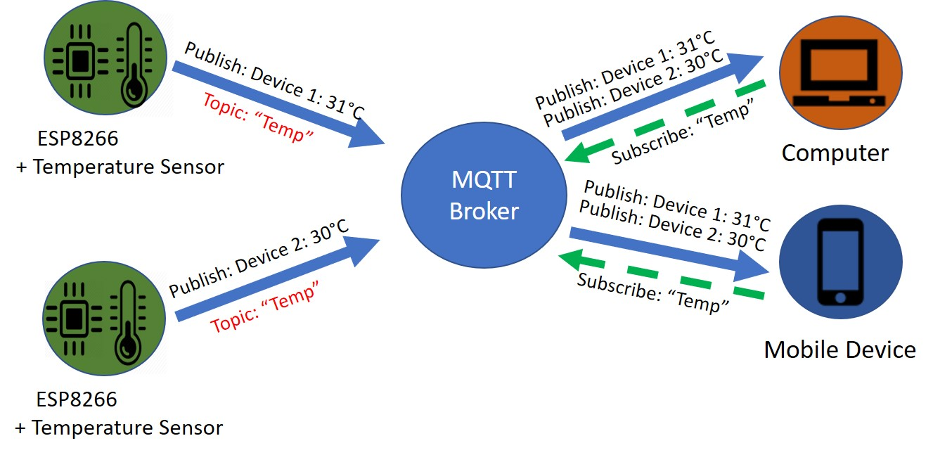
MQTT
Messaging protocol for IOT systems
Chosen because
Popular and simple
Team already familiar with it
Topics: UID/<topic name>
CAN
GPS
Command
Error
Message Format
{ “msg_id”: “<CAN id #>”, “payload”: “<CAN data>”, “timestamp”: “<time>”}

Slide 28
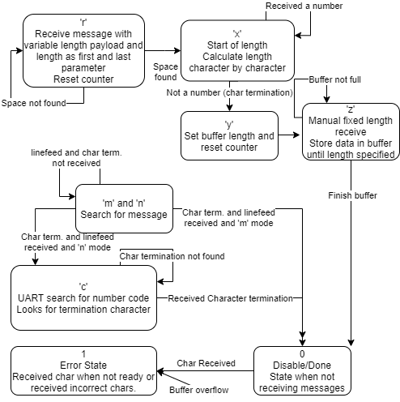
Wireless Configuration
Wireless modules are configured by AT commands.
Uses Interrupt for receive due to variable length nature of Response codes.
Wi-Fi pushed for future goals due to issues getting UART setup.
GPS data is to be received over second UART port ‘UART3’. Additional information from GPS includes time and date, location, and speed information.
Potential Future used for FC-20 (not N version), Bluetooth for future sensors.

Slide 29
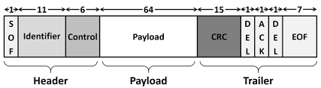
Data Collection
Goals:
Interrupt-driven reception from CAN Bus
Save data to microSD
Process:
Initialize CAN in MX_CAN_Init
Overwrite receive interrupt callback function
Start data collection
Create FAT file system
Write data to text file
Future improvements: Loopback reception and filters

Slide 30
Back-End Software
Server Scripts, Data Analytics

Slide 31
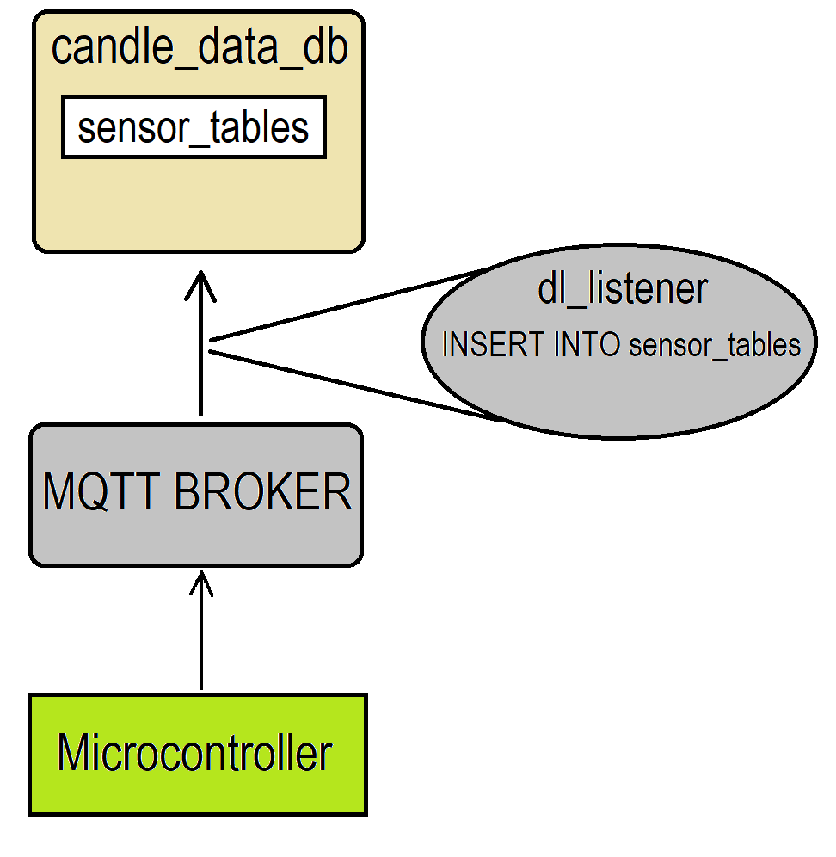
Server-Side Software
Objective: Data decoding and Data Storage
MQTT Broker
Mosquitto broker service
SUB/PUB model
MySQL Server
Candl_data database
Tables by CAN message ID
Store historical CAN data

Slide 32
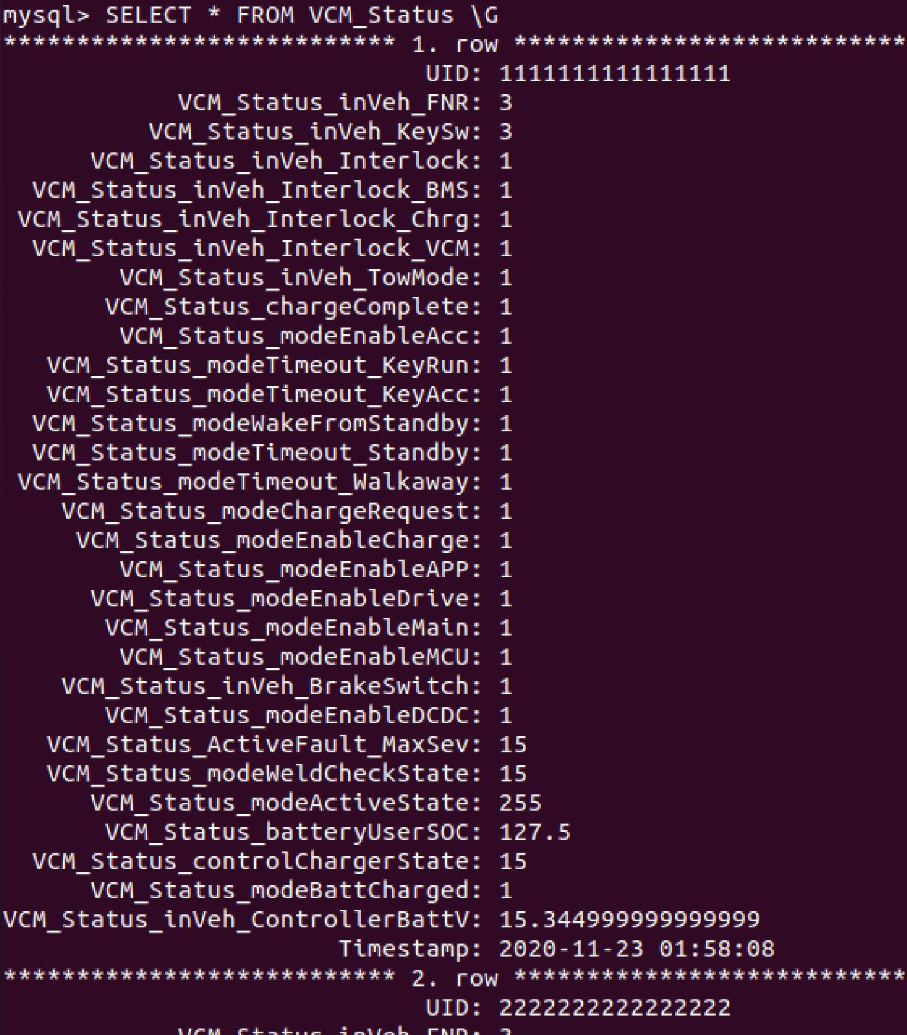
Server-Side Software
Python Scripts
MQTT Listener Client
Subscribed to all MQTT topics
On message receive, decode the message payload
Pass decoded payload to SQL insertion functions
Database Manager
Establish connection to SQL database
Format data into SQL query
Use query to insert data into tables

Slide 33
Project Management
Bill of Materials, Budget

Slide 34
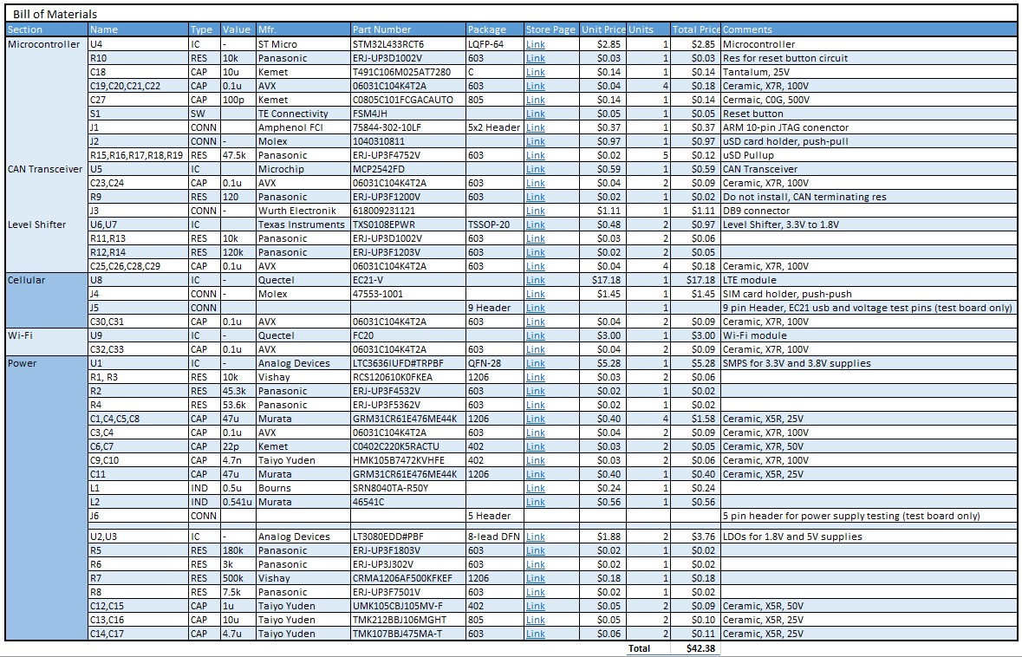
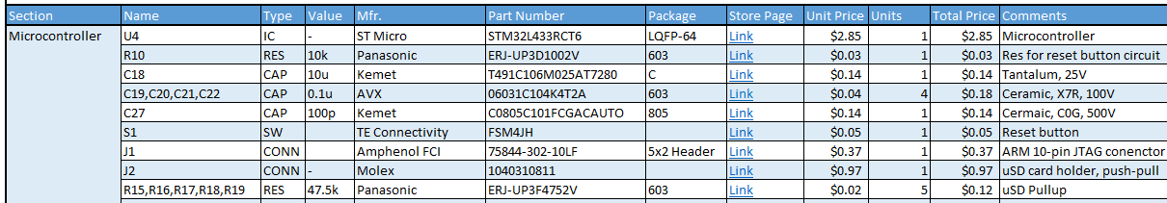
Bill of Materials
Target price: $50
Actual price: $42.38

Slide 35
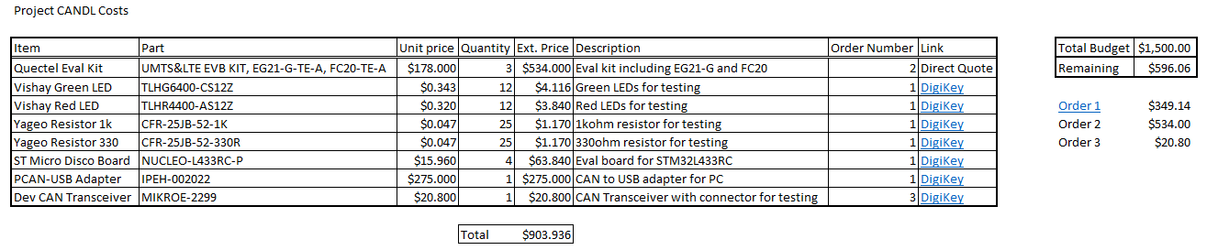
Budget
Total project budget: $1500.00
Total development cost: $903.94

Slide 36
Questions?
live DEMO

